Slide 1
Peer Analysis Report Guide
Simon Thomson
elogbook clinical lead
S.Thomson@elogbook.org

Slide 2
Peer Analysis Report
What is the peer analysis report?
The peer analysis report is a new logbook report available to StRs and Core trainees that is designed to compare an individual's operative experience to national data. It consists of four charts as follows; operating “growth” chart, supervision ratio chart, unbundling chart and breadth of training chart. Logbook specialty leads control which data items are displayed.
How do I get my peer analysis report?
login
click on reports
select peer analysis and complete the other fields
The report will be generated as a downloadable pdf
It is expected to become available in your ISCP portfolio in due course. You can produce your peer analysis report as often as you wish.
Is the data current?
Yes, the trainee and the background data are both generated from scratch every time the report is generated.

Slide 3
Peer Analysis Report
Who can see my report?
You
“Directors” for your training programme. Generally this is the TPD, SAC liaison member and Head of School of Surgery.
Once the report becomes available in your ISCP portfolio it will be visible to anyone who has access to your portfolio.
The logbook admin and development team.
Can I turn the report off or modify it for my account
No, sorry.
I need help or want to provide feedback
Please contact the helpdesk: helpdesk@elogbook.org
Thank-you for all feedback, we need it to help improve the logbook.

Slide 4
Peer Analysis Report
How is the peer data calculated?
The logbook uses peer data from confirmed StRs or core trainees who are registered as training in that specialty and where training year has been recorded annually. The last 8 years of data is used. The data is recalculated continuously.
LTFT, Academic trainees, OOPs etc.
The logbook does not “know” whether an individual is full time or not but there is a record of training year which may not necessarily be a year long. The graphs use the recorded training year, please ensure you keep this up to date.
Is the background data accurate?
Some care should be taken in relying too much on the absolute numbers. The main difficulty we have is that, until recently, training year has been poorly recorded in the logbook and this results in a lot of data being excluded. Consequently, particularly in small specialties, the number of data items we can use is sometimes quite low. Please help us by ensuring your training year, specialty and grade are kept up to date.
Is the individual’s data accurate?
As far as we know, yes. This is however a new report – if you think your data is incorrect then please check that your training year, grade and specialty are recorded accurately and note that the breadth of training graph uses only 1st surgeon data. Still not sure? – contact the logbook helpdesk.

Slide 5
Operating “Growth” Chart
Which operations count?
Currently all procedures at all supervision levels but the procedure list can be restricted by the specialty logbook lead / SAC if required.
The centiles seem inaccurate
In small specialties the number of data items we can use is low. The graphs should improve over time as training year is being recorded more accurately now but please help by ensuring your training year is correct.
Interpreting the chart
Conceptually this chart is similar to a paediatric growth chart. The lines are centiles which is to say that 25% of StRs will be above the 75th centile and 75% below it. As with height and weight charts, following a centile is generally expected whereas crossing centiles may represent a change in activity.

Slide 6
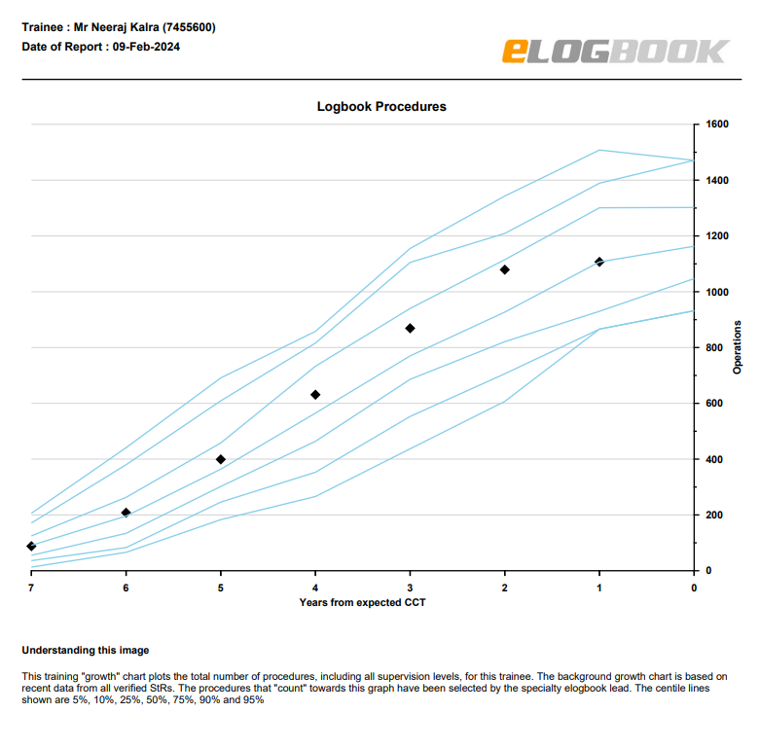
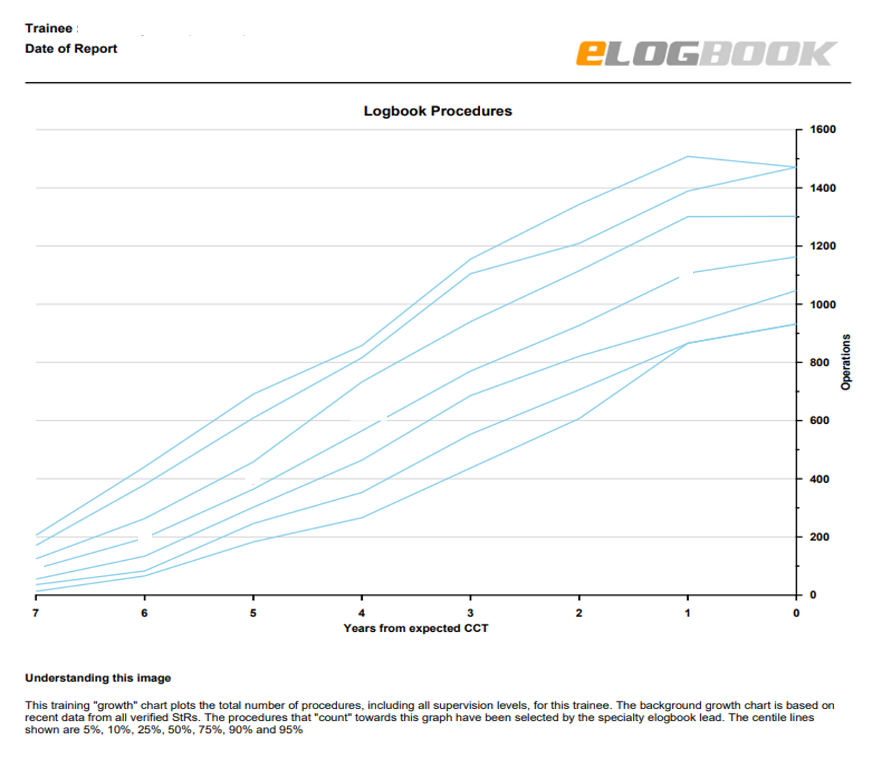
Operating “Growth” Chart examples
StR with low experience in the first 3 years but with a rapid increase in experience in the last 2 years. Three years to go until CCT.
StR with typical experience just above the 50th centile. Three years to go until CCT.

Slide 7
Supervision Ratio Chart
Which operations count?
Currently all procedures at all supervision levels but the procedure list can be restricted by the specialty logbook lead / SAC if required.
What is meant by first surgeon?
First surgeon is calculated by adding P, S-TS, S-TU and T together. In these graphs this is then compared to A. Observed cases (O) are not included.
Interpreting the chart
This chart is designed to show the proportion of cases that a trainee is doing all or part of. There is no distinction between P, S-TS, S-TU or T as they all suggest that a trainer is sufficiently confident in a trainee’s ability to allow them to do at least part of the operation. The proportion of 1st surgeon cases normally rises as training progresses. The bars show the national means.

Slide 8
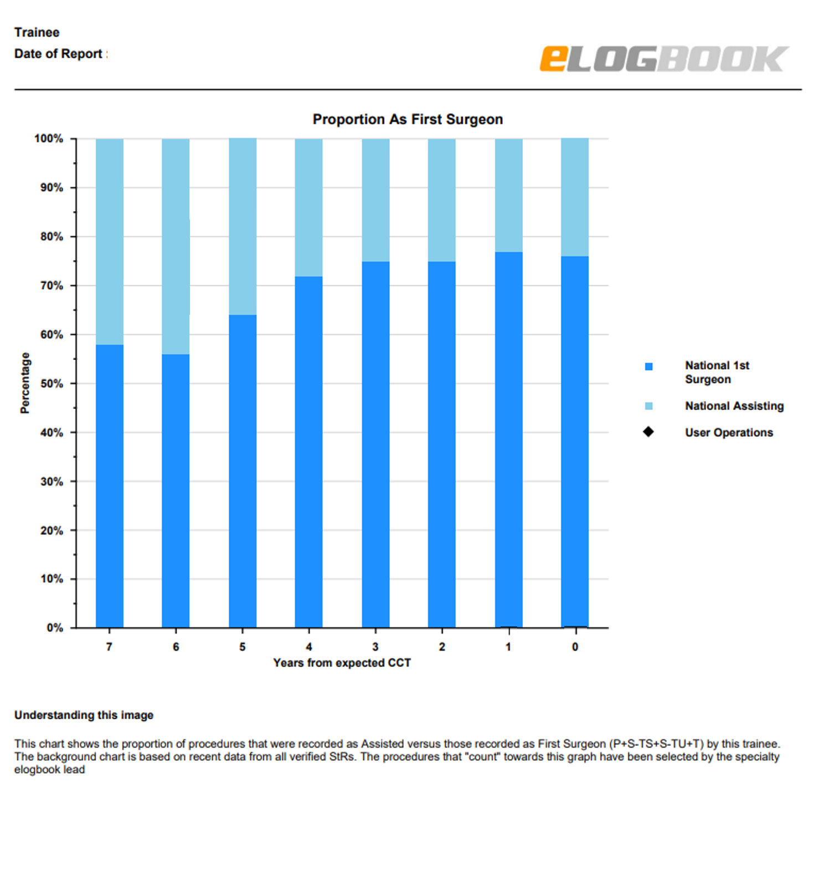
Supervision Ratio Chart examples
StR with above average levels of independent operating in the first 3 years but declining independence in the last two. Three years to go until CCT.
StR with typical supervision ratios. Three years to go until CCT.

Slide 9
Unbundling Chart
Which operations count?
Currently all procedures at all supervision levels but the procedure list can be restricted by the specialty logbook lead / SAC if required.
What is meant by unbundling ratio?
A case is counted as unbundled when more than one procedure is performed on the same patient on the same day. The total number of unbundled cases is then expressed as a percentage of all cases.
Interpreting the chart
There are situations in surgery where multiple procedures may be performed at the same time on a single patient or concurrently within a few hours. The unbundling ratio should not therefore be zero. However, deliberately breaking a single procedure up into multiple procedures to push up logbook numbers has been identified as a problem in some specialties and is not uniformly distributed. The unbundling index has been developed to counteract this practice. The chart shows the trainee, training programme and national figures over the last year and throughout training.

Slide 10
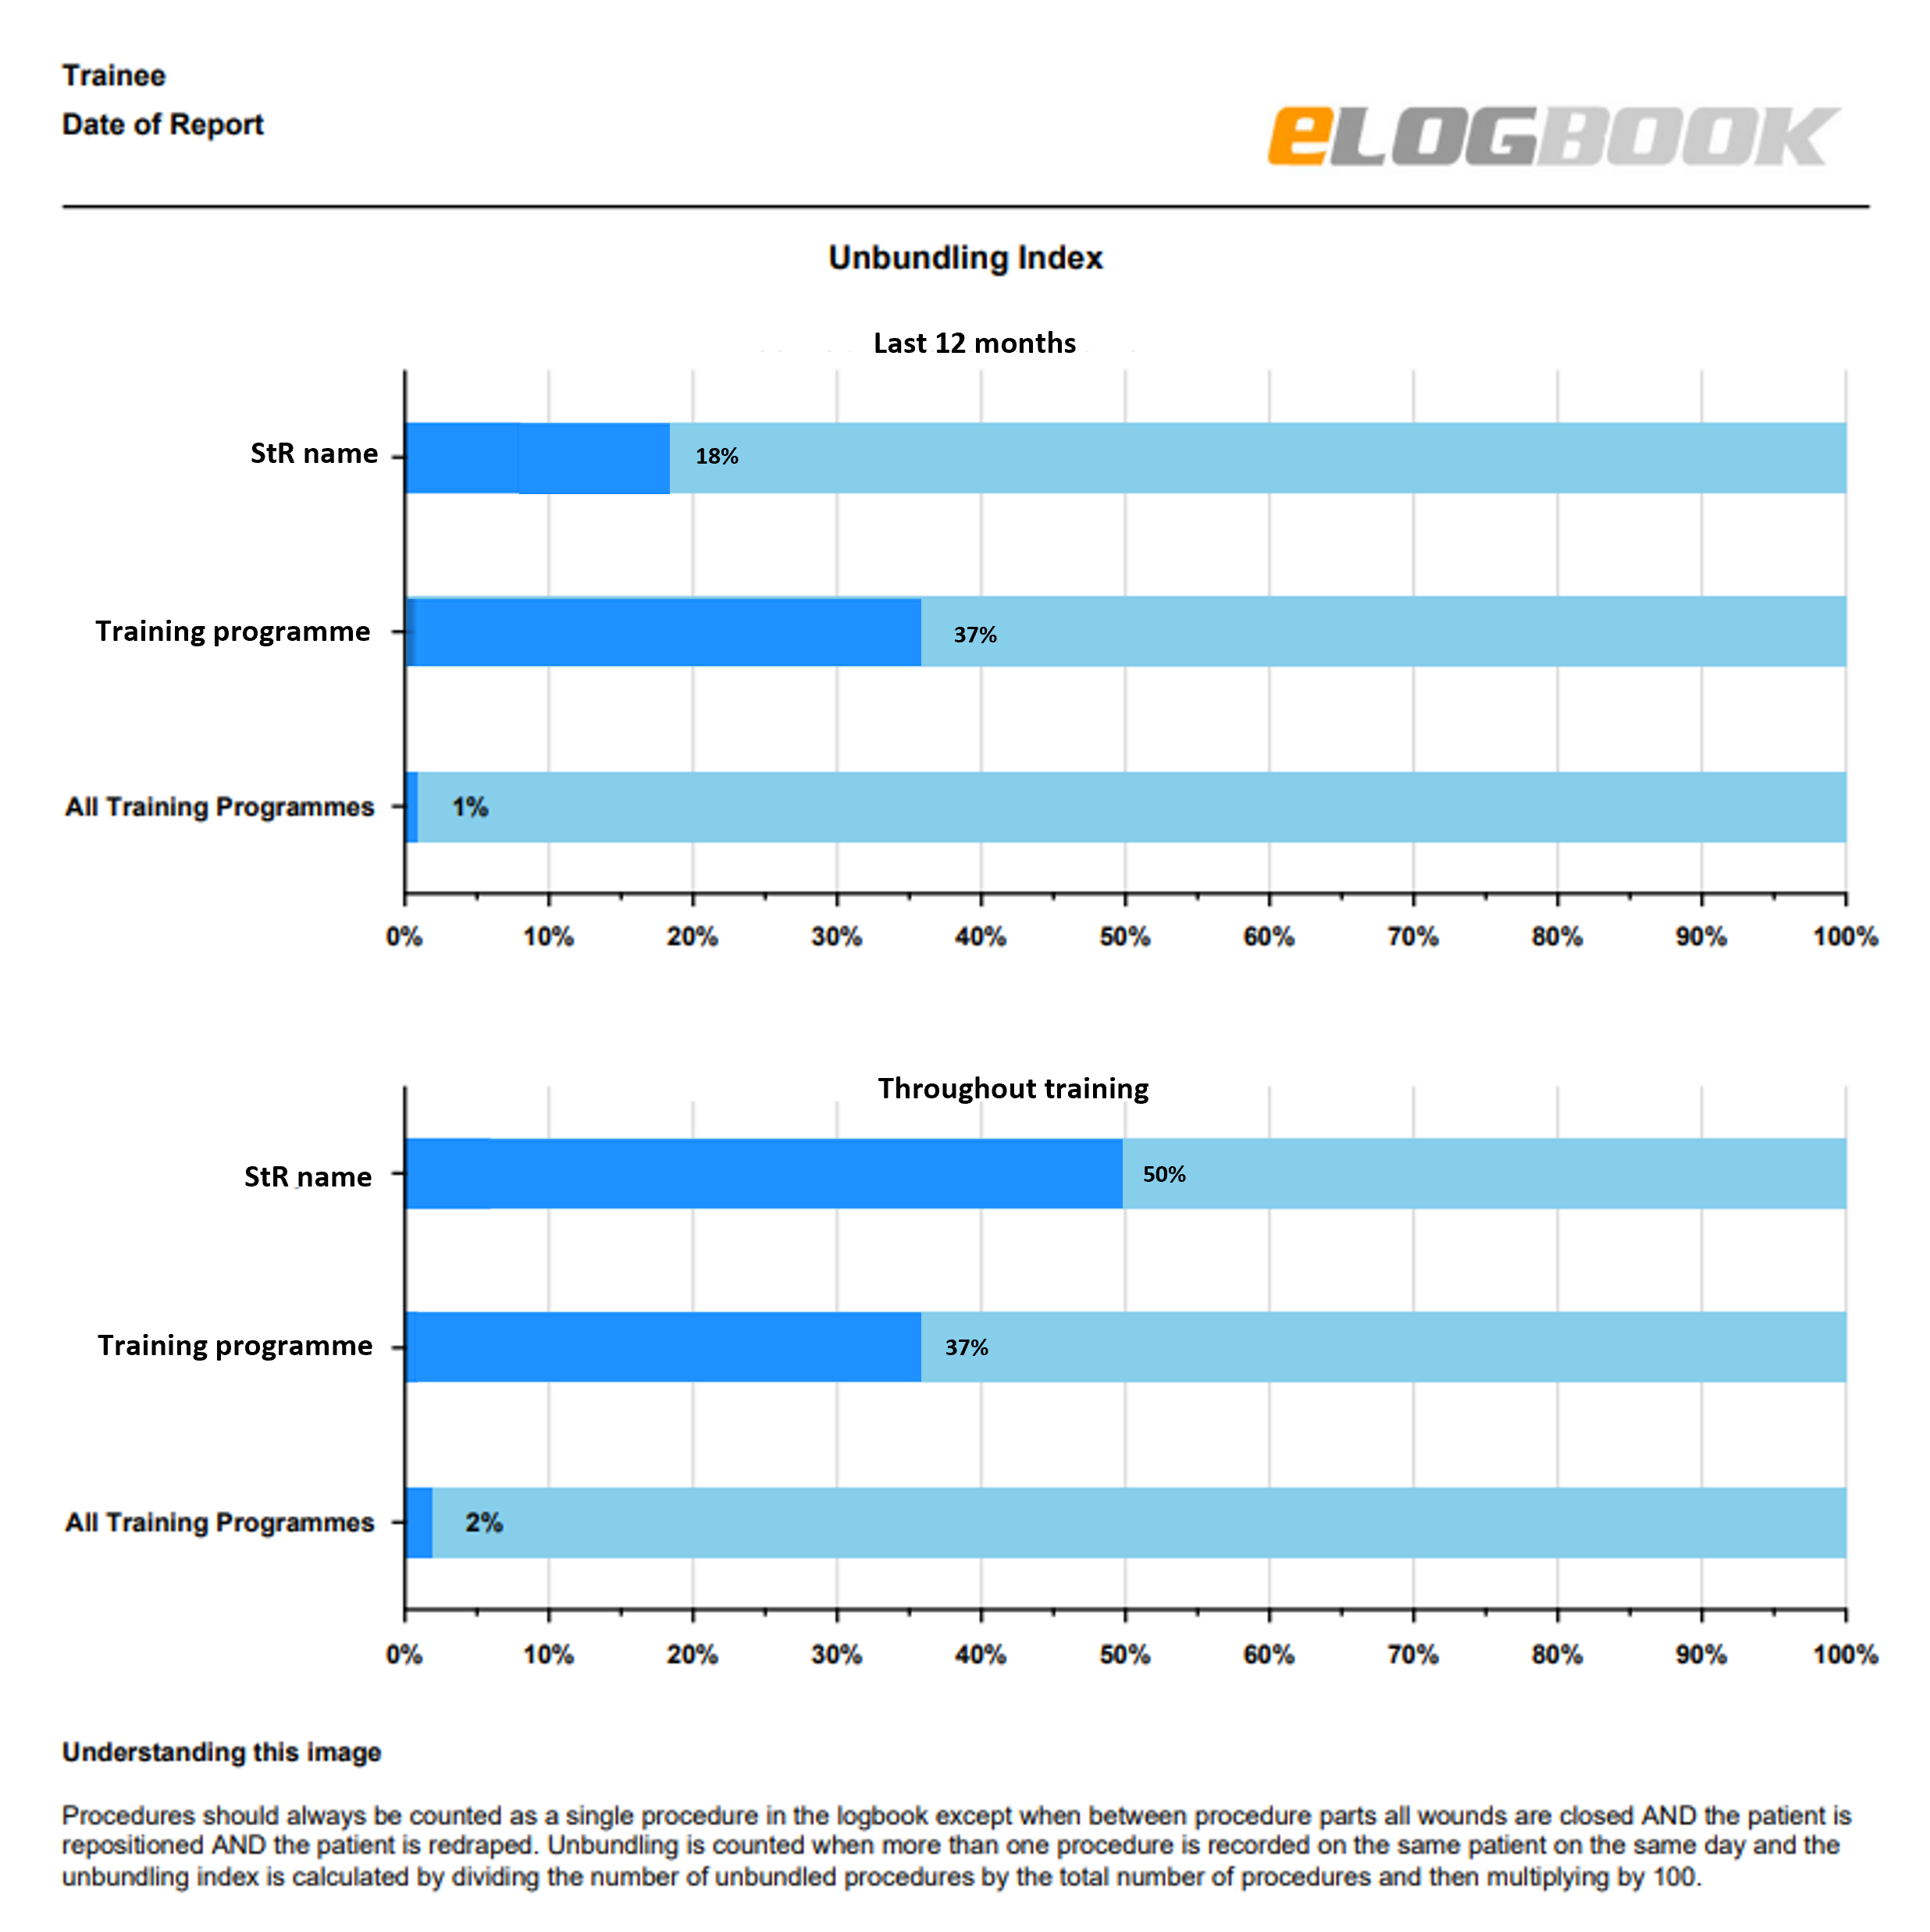
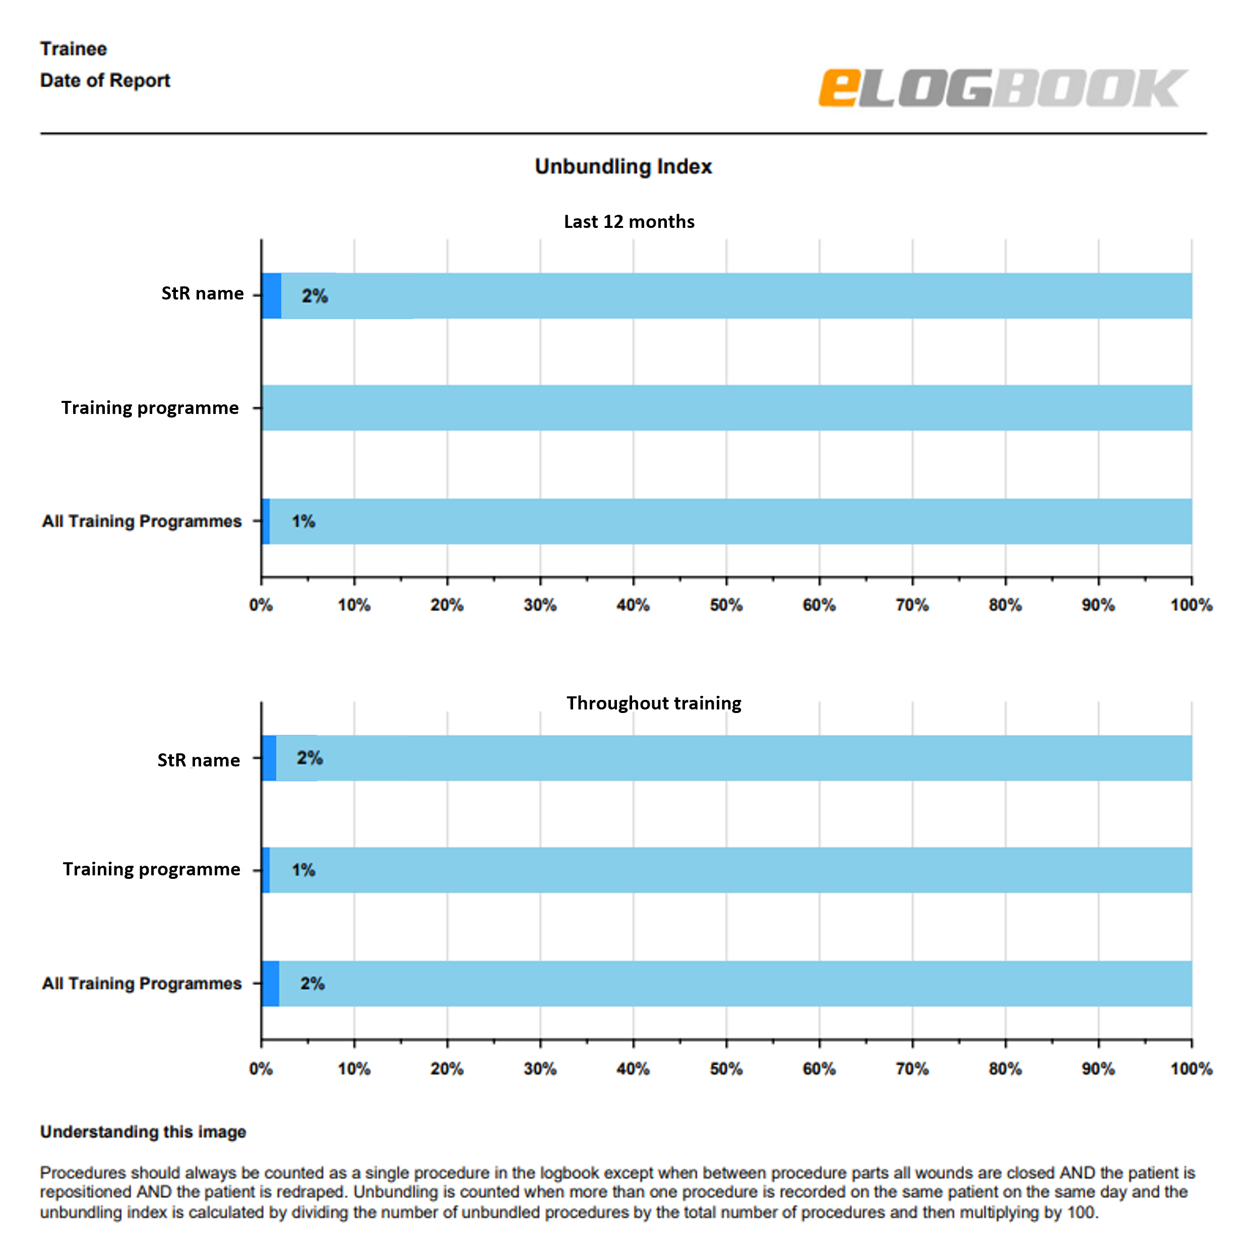
Unbundling Chart examples
A training programme with very high unbundling ratios to which the trainee has contributed. The trainee has achieved lower (but still substantially higher than national averages) unbundling ratios in the last year.
A typical training programme and a typical trainee both reflecting national averages.

Slide 11
Breadth of Training Chart
Which operations count?
The categories and procedures that count are defined by the logbook lead and SAC. Please note that unlike the other charts only first surgeon cases are shown. First surgeon is calculated by adding P, S-TS, S-TU and T together.
How are the national columns calculated?
For ST3 – ST8 the national columns are calculated from final year trainees in that specialty. Conversely for core trainees, ST1s and ST2s the CT2 / ST2 figures for that specialty are used.
Interpreting the chart
This chart is designed to show which areas of a specialty a trainee has had more (or less) experience in. It is designed to facilitate discussion between trainees and trainers on how best to optimise where a trainee should rotate to.

Slide 12
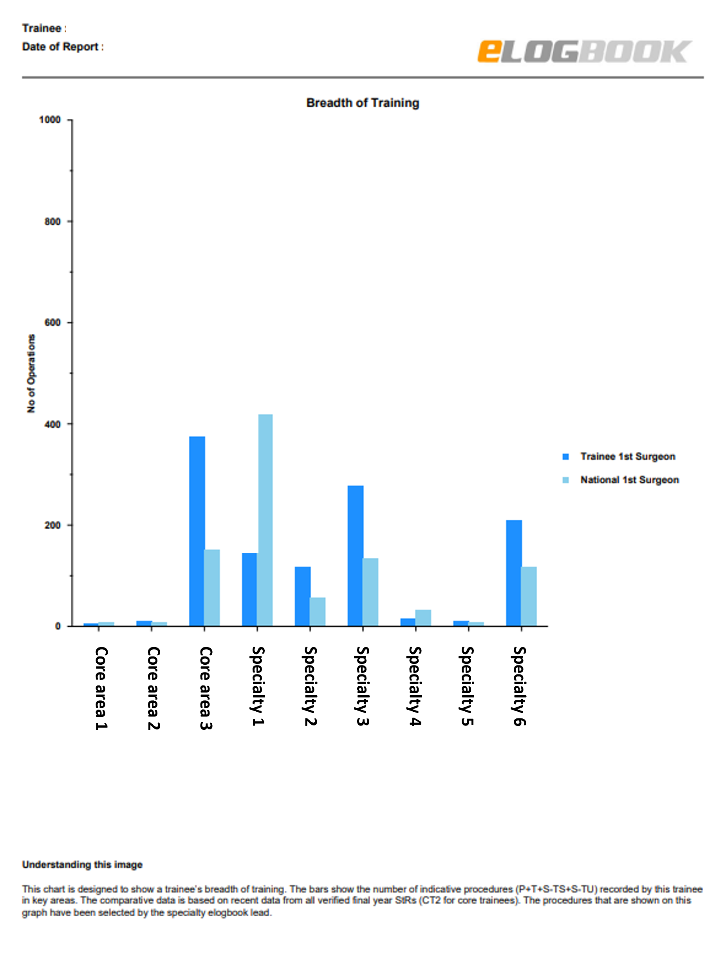
Breadth of Training Chart example
An StR with low but typical experience in core areas 1 and 2. They have a lot of experience in core area 3 and several specialty areas that exceed average levels achieved by final year trainees but lower than average experience in specialty areas 1 and 4.

